Slide 1
Computer Vision Crusaders
Object Classification in Urban Aerial Drone Footage

Slide 2
Previous Solutions
Wildlife Detection With Drones
Images of different wildlife in various habitats
SE-YOLO model: Effective for classifying small targets
Stanford Drone Dataset
Video data of bikers, pedestrians, cars, etc…
Goal: Target trajectory forecasting - Predict social etiquettes and common sense behavior

Slide 3
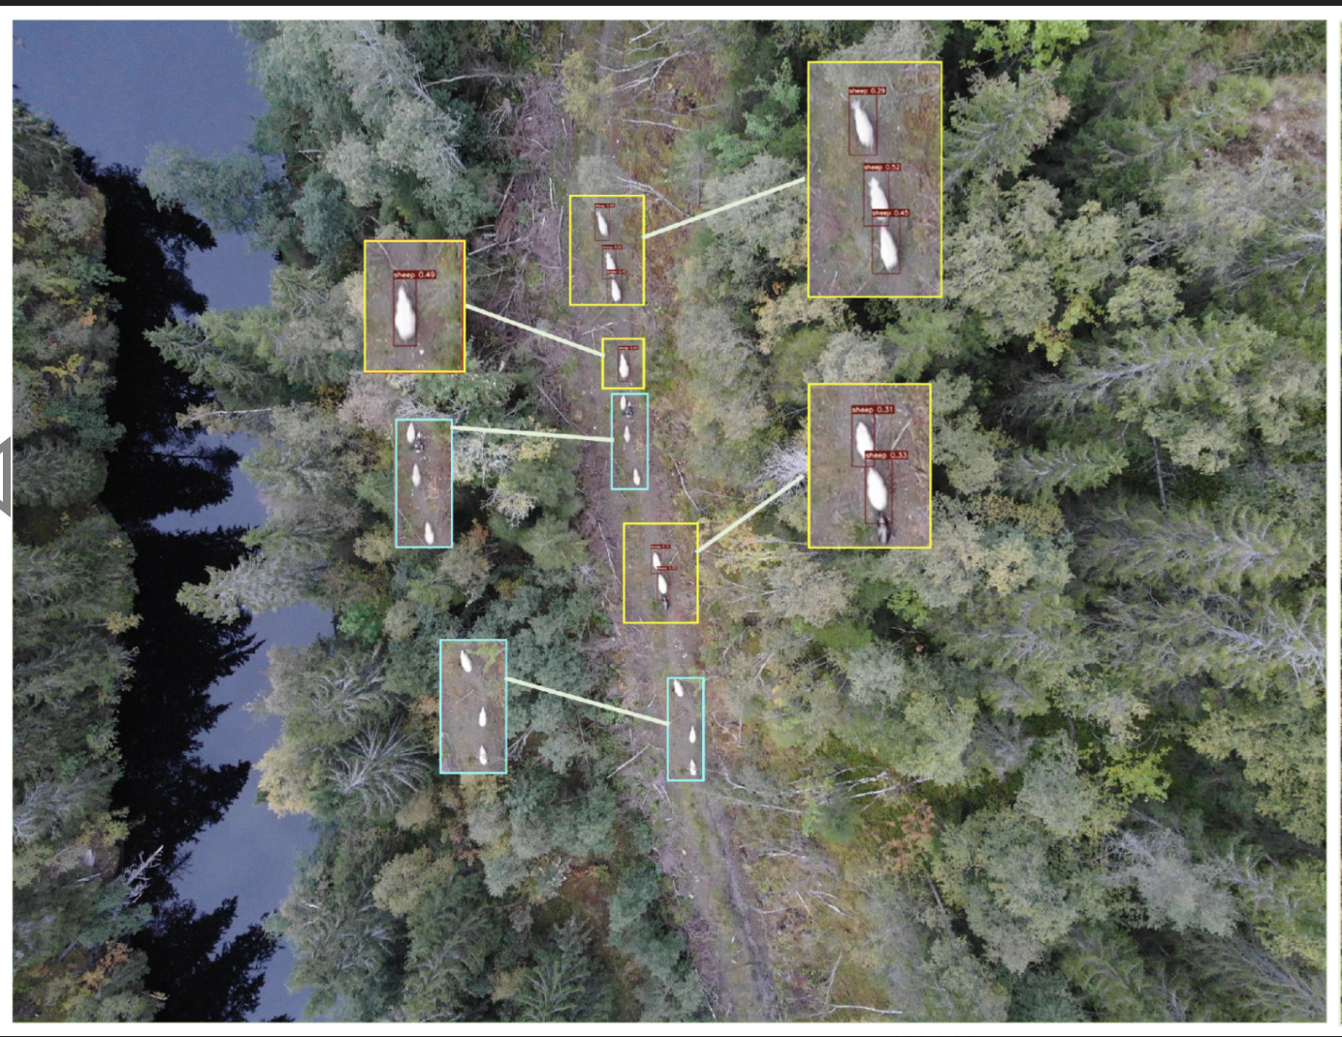
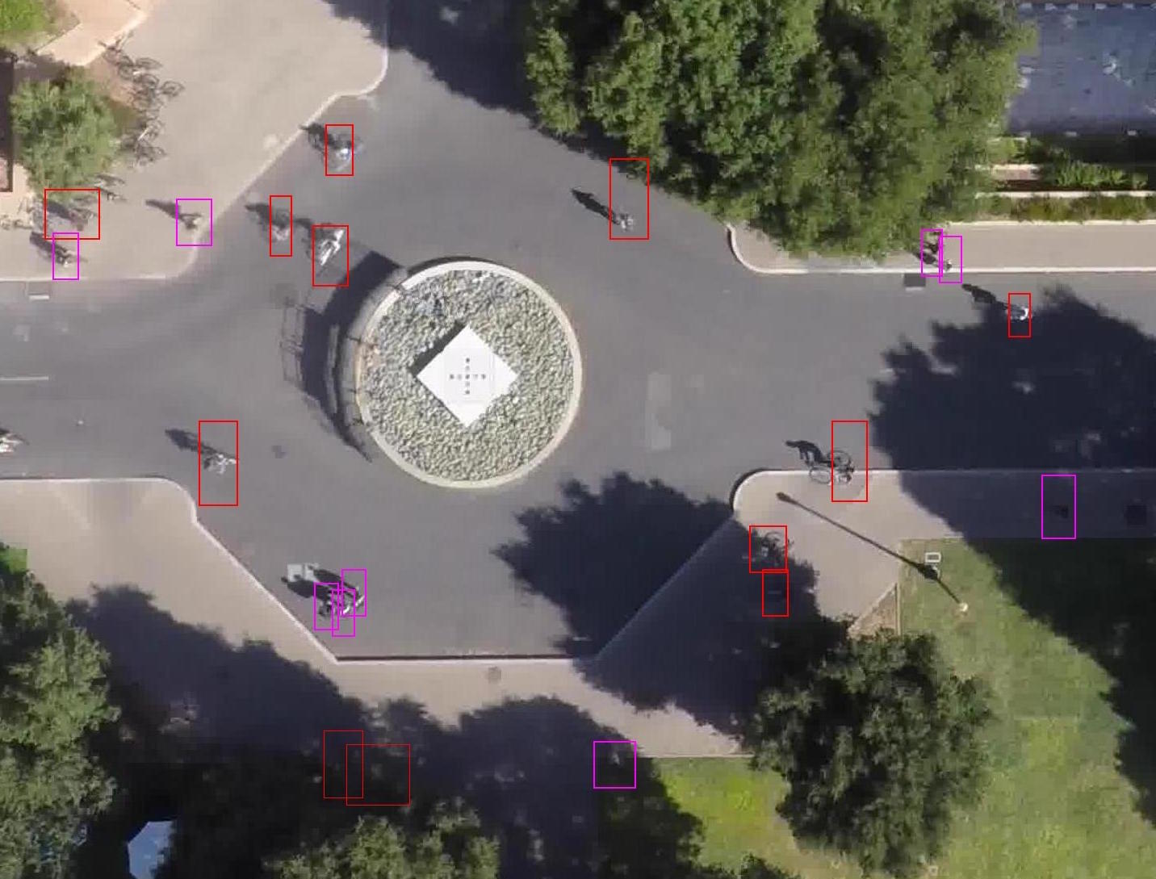
Wildlife Detection With Drones
Stanford Drone Project

Slide 4
Dataset
VisDrone Challenge
Annual challenge held by Tianjin University and has become a standard benchmark in drone-based object detection
Each year, datasets include footage from various Chinese urban and rural settings
Example: 2019 Challenge
~300 videos
~260,000 frames
~10,000 images
Github repo

Slide 5
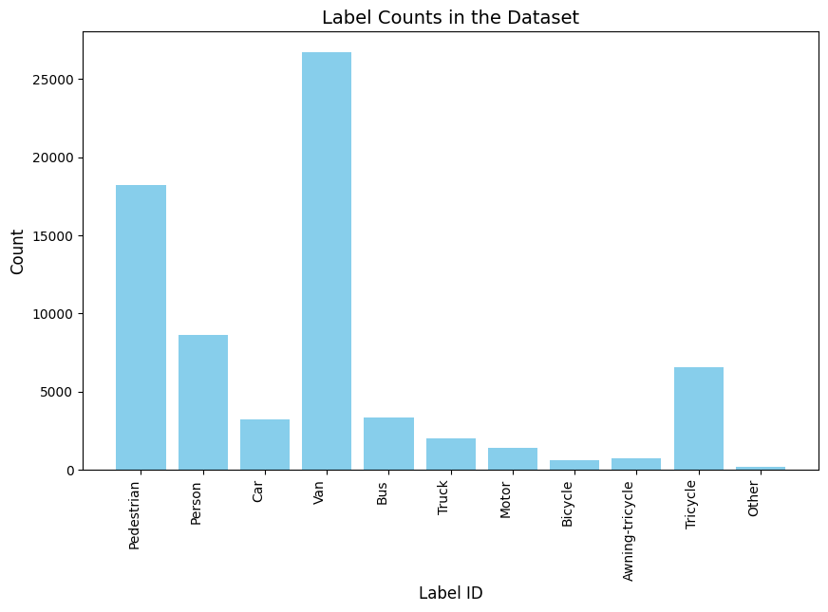
Data Exploration
Sample Data subset (1000 images):
def count_labels_in_image(annotations):
def accumulate_label_counts(dataset_annotations):

Slide 6
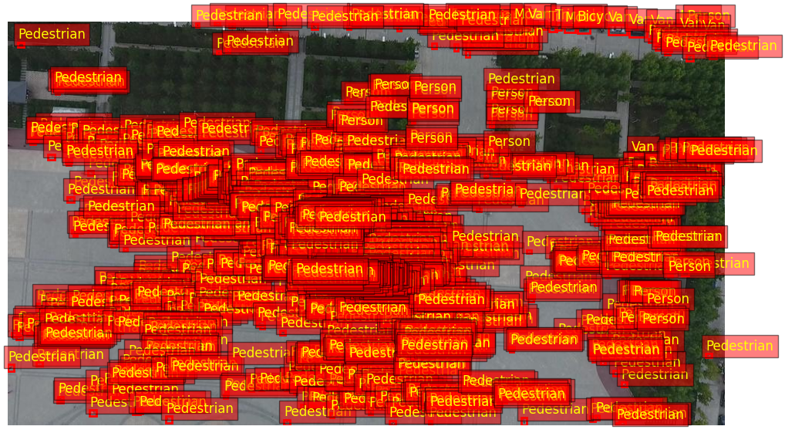
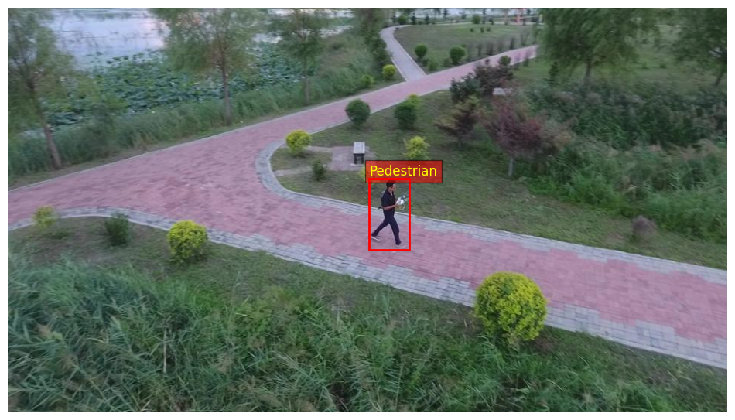
def count_most_and_least_boxes(annotations):
Least boxes:
Image: 134
Boxes: 1
Most boxes:
Image: 51
Boxes: 902

Slide 7

Data Preparation
Merging pre-split training, validation, test datasets
Perform own data shuffling + partitioning
Removal of ‘Ignored’ labels in training data
Creating a data loader
Standardize Image Size
Data Augmentations

Slide 8
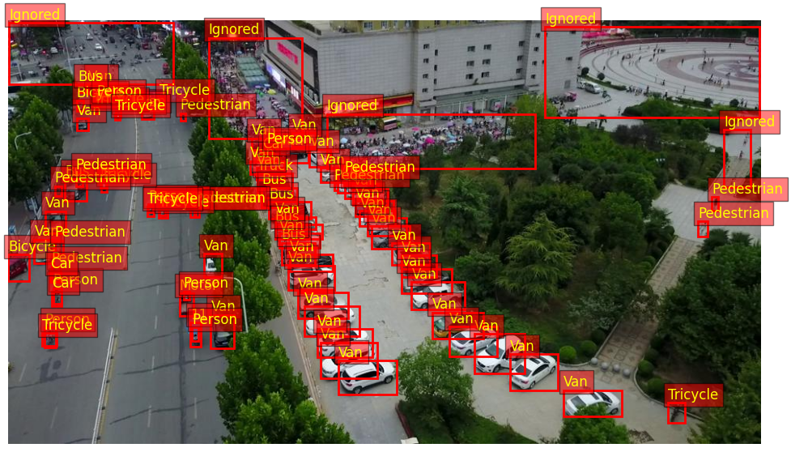
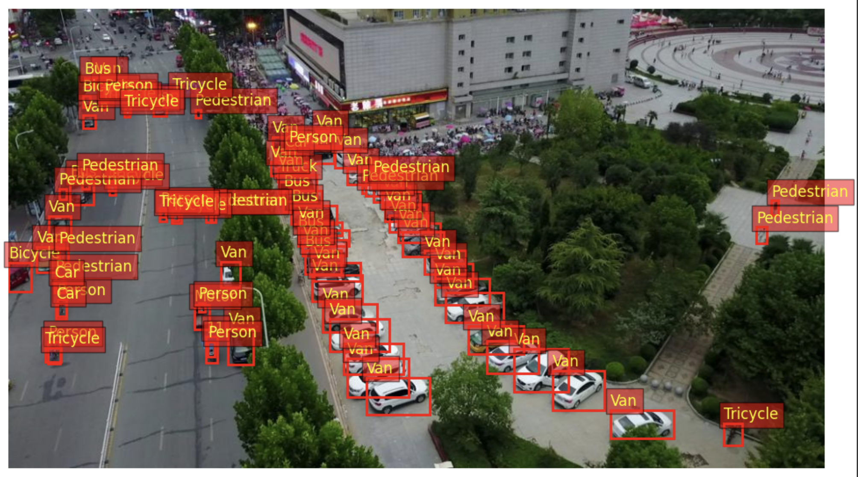
Example
Original Image
Re-labeling

Slide 9
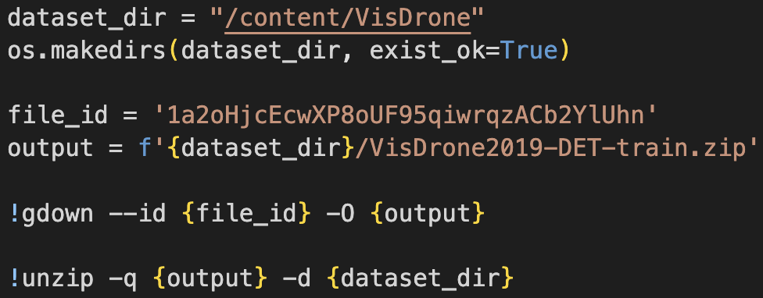

Challenges
Accessing dataset from VisDrone
Handling complex “label” data
Merging multiple datasets

Slide 10
Next Steps
Choosing the right model for specific object detection task
YOLO
R-CNN
Zero Shot
Customize Data Loader to prep images for chosen architecture

